Slide 1

Petrol Price Data(1990-2008)
Sayan Karmakar
Last update =02/11/2022

Slide 2
Questions We Asked
1. Price deferens betanin USA, Australia & South Korea.
2. Gas Price deferens in Europe Countries.

Slide 3
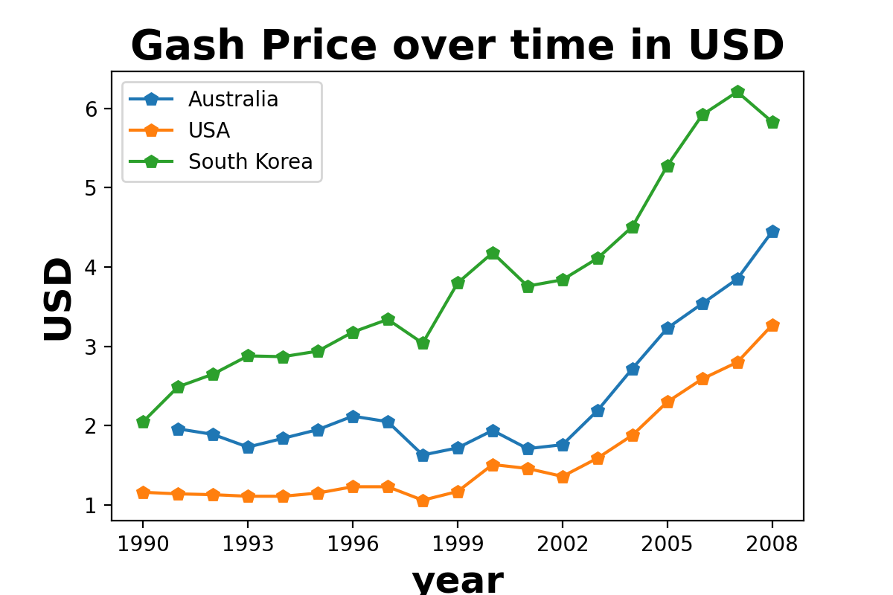
Price deferens
We can see in our line graph gas prize incise in 3 Countries (Australia, USA & South Korea) from 1990 – 2008.

Slide 4
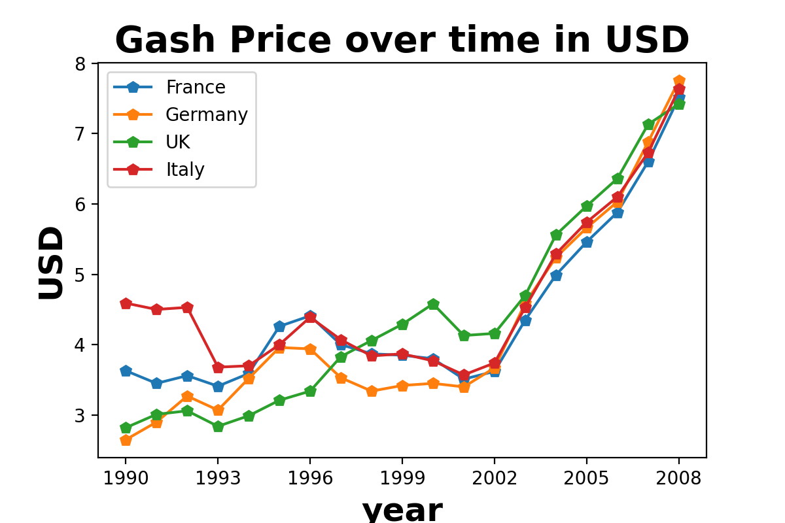
Gas Price deferens in Europe Countries.
We can see in our line graph gas prize incise in 3 Countries (France, Germany, UK, Italy) from 1990 – 2008.

